Slide 1


Mansoura University Faculty of Computers and Information Second Semester- 2025-2026
OOP Project
Restaurant with Calorie Management System
مطعم مع نظام حساب سعرات الطعام
SEC: 48
Eng. Mohammed Kamal

Slide 2
Abstract
This project aims to develop a self-ordering system for a modern restaurant that also provides calorie tracking for customers. Unlike traditional ordering methods, the system allows users to browse the menu, select their desired items, and customize their orders independently through an easy-to-use interface. In addition to calculating the total price, the system also displays the total calorie intake of the selected items, helping customers stay aware of their daily consumption.
The system will be implemented using C# and will follow Object-Oriented Programming (OOP) principles such as encapsulation, inheritance, and polymorphism. Each menu item will be represented as an object containing attributes like name, price, and calorie count, allowing for flexible and scalable system design.
The expected outcome is a smart, user-friendly application that enhances the customer experience through self-ordering while promoting healthier eating habits by providing clear calorie information. It also demonstrates the practical application of OOP concepts in building real-world restaurant management solutions.

Slide 3
Team members
ID | Name
1000324251 | Youssef Mohamed Mahmoud Mohamed Roshdy
1000324138 | Youssef Mohamed Mahmoud Mohamed Allam
1000324687 | Youssef Mohamed Kamal Abdelmegid Ashour
1000324284 | Youssef Mohamed Youssef Mohamed Youssef
1000324598 | Youssef Mamdouh Mohamed Youssef Ali
1000323999 | Youssef Walid Ebrahim Abdo Elkhayat

Slide 4
1. Introduction
With the rapid advancement of technology, the food service industry is increasingly adopting digital solutions to enhance customer experience and improve efficiency. One of the most popular trends is the use of self-ordering systems, which allow customers to browse menus and place orders without direct interaction with staff.
This project focuses on developing a smart self-ordering system for a restaurant that not only simplifies the ordering process but also provides valuable nutritional information. The system enables customers to select meals, customize their orders, and instantly view both the total price and the total calorie intake of their choices.
By integrating calorie tracking into the ordering process, the system helps customers make more informed and healthier decisions based on their dietary needs. The application is built using C# and follows Object-Oriented Programming (OOP) principles to ensure a structured, scalable, and maintainable design.
Overall, this project aims to combine convenience and health awareness in a single user-friendly solution, demonstrating how modern software techniques can solve real-world problems in the restaurant industry.

Slide 5
2. Problem Statement
In many restaurants, especially traditional and mid-scale ones, the ordering process still relies on manual interaction with staff, which can lead to delays, order inaccuracies, and limited customization options. Additionally, customers often lack access to clear nutritional information about the meals they order, making it difficult to monitor their daily calorie intake or make healthier food choices.
With the growing awareness of health and nutrition, customers are increasingly interested in understanding what they consume. However, most restaurant systems focus only on pricing and order management, ignoring the importance of calorie tracking and dietary awareness.
Therefore, there is a need for an integrated system that allows customers to independently place orders while also providing real-time information about both the cost and the calorie content of their meals. Such a system should be simple, efficient, and user-friendly, while also demonstrating effective use of Object-Oriented Programming (OOP) principles in its design and implementation.

Slide 6
3. Objectives
The main objective of this project is to design and develop an integrated restaurant ordering system that improves the ordering process while promoting healthier food choices through calorie awareness.
More specifically, the system aims to:
Develop a user-friendly application that allows customers to easily browse the menu and place orders without staff intervention.
Automate the calculation of total order price based on selected items and quantities.
Provide real-time calculation and display of calorie content for each meal and for the total order.
Reduce human errors and delays associated with traditional manual ordering systems.
Support customers in making informed dietary decisions by displaying nutritional information clearly.
Apply Object-Oriented Programming (OOP) principles effectively in system design, including encapsulation, inheritance, and polymorphism where appropriate.
Improve overall efficiency and organization of the restaurant ordering process.

Slide 7
4. Features
Digital Menu Display: Shows all available food items with descriptions, prices, and calorie information.
Order Placement System: Allows customers to select food items and specify quantities easily.
Real-Time Price Calculation: Automatically calculates the total cost of the order based on selected items.
Calorie Tracking: Displays calorie content for each item
Customizable Orders: Enables customers to modify quantities or remove items before finalizing the order.
User-Friendly Interface: Simple and intuitive design to ensure easy navigation for all users.
Order Summary: Provides a final review of the order including items, total price, and total calories before confirmation.
OOP-Based Structure: System is developed using Object-Oriented Programming principles to ensure modularity, scalability, and maintainability.

Slide 8
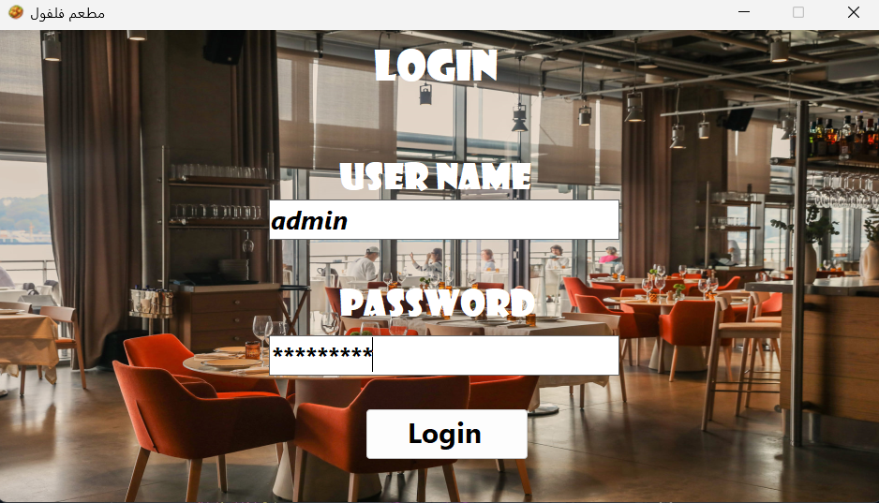
LogIN

Slide 9
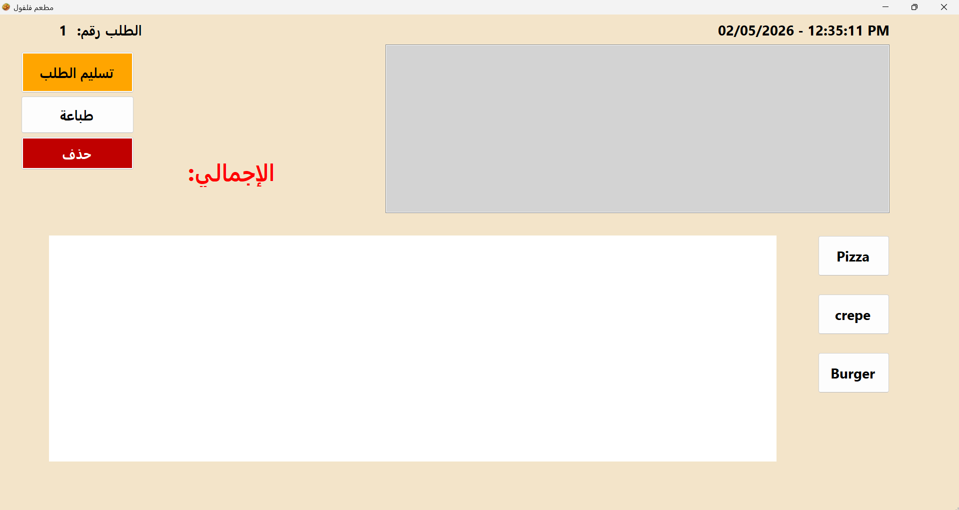

Slide 10
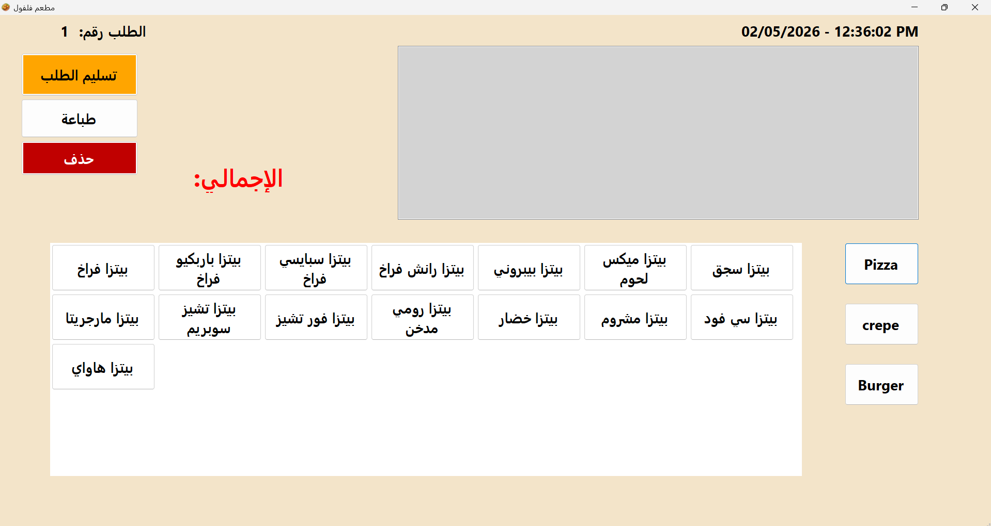

Slide 11
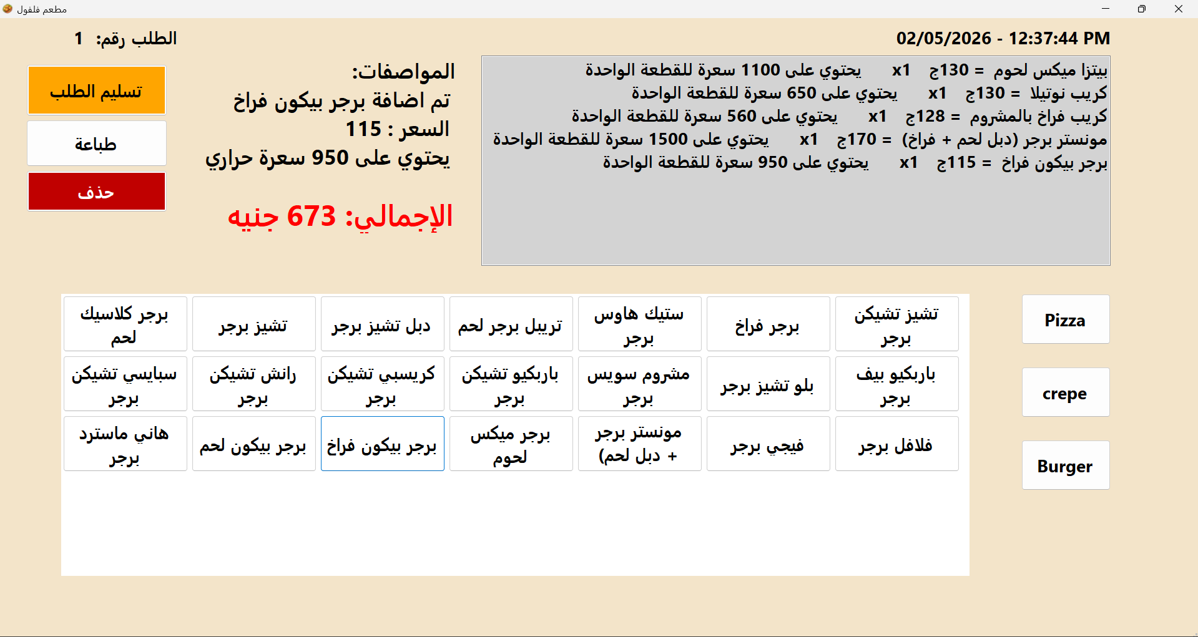

Slide 12
